Slide 1
Software Engineering Day 2 ELITE

Slide 2
Introduction to Requirement Analysis –Use Case modeling

Slide 3
Actor
An actor is a role (a class), not an individual instance.
An actor must have some association with one or more use cases.
Although, an actor might not initiate a use case, he may communicate with a use case.

Slide 4
Use case development –Actor guidelines
Following questions to be asked when identifying actors
Which user groups
Are supported by the system to perform their work?
Execute the system’s main functions?
Perform secondary functions -such as maintenance and administration?
With what external SW/HW the system will interact
Identify Scenarios: A scenario is single feature of the system in single actor’s view point.
Scenarios captures concrete event rather than general/ complete description
Or, in the case of a new system, what users will be doing with the system?
Use cases focus on the behavior of the system from an external point of view
Identification of actors and use cases leads to definition of system boundaries (tasks accomplished by the system and tasks accomplished by its environment)

Slide 5
Effective Use case development –Guide lines
Use case should be named with verb (Ex. Report Emergency)
Actor should be named with a noun phrase (Ex. Administrator, Dispatcher)
Boundary of the system should be clearly distinguished
Identify steps accomplished by actor
Identify steps accomplished by system
An use case should describe complete transaction
ReportEmergency – describes all the steps between initiating emergency reporting and receiving an acknowledgement
Use cases should not describe the user interface of the system –menu button etc.
Use extend relationships to decompose a bigger use case into smaller ones

Slide 6
Use-Case Diagram (Con’t)
A use-case diagram is a graph of actors, a set of use cases enclosed by a system boundary, communication (participation) associations between the actors and the use cases, and generalization among the use cases.
<<initiate>>
<<participate>>
Notes:
A Use-case diagram shows the relationship among actors and use cases within a system.

Slide 7
Actor Notations
The three representations of an actor are equivalent.

Slide 8
Communication relationships
Communication relationships between actors and use cases captures flow of information during the use case.
<<initiate>> stereo type denotes initiation of use case
<<participate>> stereo type denotes an actor communicates with the use case and did not initiate the same
<<extend>> An use case extends another use case if the extended use case may include the behavior of the extension under certain conditions.
Used for separation of exceptional and optional use cases
Both extended use case and extensions are complete use cases
Ex: FieldOfficer
ReportEmergency ← <<extends> ConnectionDown
<<include>> Redundencies among use cases can be factored out
Ex. openIncident → <<include>> viewMap
Notes:
A use-case description can be difficult to understand if it contains too many alternatives or exceptional flows of events that are performed only if certain conditions are met as the use-case instance is carried out. A way to simplify the description is to take advantage of extends and uses associations. The extends and uses associations often are sources of confusion, so let us take look at these relationships.

Slide 9
<< participate >>
<<initiate>>
<<include>>
<<extends>>
Notes:
The similarity between extends and uses associations is that both can be viewed as a kind of inheritance. When you want to share common sequences in several use cases utilize the uses association by extracting common sequences into a new, shared use case. The extends association is found when you add a bit more specialized, new use case that extends some of use cases that you have.

Slide 10
Loan Management System (LMS)

Slide 11
Loan Management System (LMS)
The Loan Management System (LMS) allows users of the system to register themselves, and apply for Home loans. An officer can view the loan requests, reject the requests or forward the request to the manger. The Manager can then sanction/reject the loan request.
After signing up with the system the visitor is identified as a customer, with an assigned customer-id.
Visitors who register with the System become Customers. Each customer has a unique id (CustomerId), using which he can login into the system. After logging in, a customer can view/update his profile, change his password and can apply for a loan. He can view the loan status after he has applied for a loan.
The manager sees the loan request only after officer verifies the documents and forwards the request. Finally, the loan is sanctioned by the manager. It is assumed the loan disbursement is done in one installment.
For every loan applied through the system a LoanApplicationId is generated. The LoanApplicationId is used to track the status of the loan, until the loan is sanctioned.
General users of the site are called “Visitors”.
The system allows the visitor to apply for a loan. When the visitor submits a temporary loan application the bank executive can contact the visitor and setup a meeting.

Slide 12
The customer can see the loan application status and the loan information. After the loan is sanctioned, a LoanId is generated for further reference. The Customer can view the loan amount sanctioned, the interest rate, terms of repayment, tenure of loan, mode of repayment and total interest, using the LoanId. Presently the mode of repayment is through debiting from Savings Bank Account.
A customer can apply for more than one home loan. The bank can sanction more than one home loan for a customer.
Types of loans: Only Home Loan is being considered for the current development.
Definitions of the terms used in LMS:
Visitor: Any one who visits the home loan site but is not yet registered.
Customer: A customer is a visitor who is already registered and has a unique CustomerId. He need not have a valid loan application/loan that is already sanctioned.
Officer: Officer is a Bank Employee, who is responsible for checking the loan application, verifying the relevant documents and then forwarding the application to the manager.
Manager: Manager is a Bank Employee, who actually sanctions the Loan. He can also change the interest rate..

Slide 13
Use case –Actor participation
Sl No | Responsibilities | Actor 1 | Actor 2 | Actor 3 | Actor 4
1. | View General Information | Visitor | Home Loan Customer | Officer | Manager
2. | Calculate EMI | Visitor | Home Loan Customer | Officer | Manager
3. | Signup | Visitor
4. | Login | Home Loan Customer | Officer | Manager
5. | Apply For Loan | Home Loan Customer
6. | View Loan Application Status | Home Loan Customer
7. | Maintain Customer Profile | Home Loan Customer
8. | View Loan Applications | Officer
9. | Process Loan Applications | Officer
10. | Maintain Interest Rate | Manager
11. | View Reports | Officer | Manager
12. | Repay Loan | Officer

Slide 14
CustomerId: Each and every customer on successful registration is given a unique ID, called CustomerId, using which he can login to the system.
LoanApplicationId: For every Loan Application submitted by the customer, an id, called LoanApplicationId is generated, which is to be used to track the status of the loan until it is sanctioned.
LoanId: When the manager sanctions a Loan, a Loan Id is generated. This id is used to refer to the details of the loan, repayment of the loan.

Slide 15
Assumptions:
Every customer has a valid savings bank account within the bank.
The bank has a Home Loan Account to which all the repayments are credited.
The bank has unlimited bank balance from which it can sanction money to any number of customers.

Slide 16
URD Look up table
S. No. | Use Case ID | Use Case Name
1 | LMS-UGI01 | View General Information
2 | LMS-UCE02 | Calculate EMI
3 | LMS-USU03 | Signup
4 | LMS-URL04 | Login
5 | LMS-UAL05 | Apply For Loan
6 | LMS-UAS06 | View Loan Application Status
7 | LMS-UMP07 | Maintain Customer Profile
8 | LMS-UVA08 | View Loan Applications
9 | LMS-UPA09 | Process Loan Application
10 | LMS-UMI10 | Maintain Interest Rate
11 | LMS-UVR11 | View Reports
12 | LMS-ULR12 | Repay Loan

Slide 17
Use case description table
Use Case ID: LMS-USU03 | Use Case Name: Signup
Description: | This use case allows a Bank Customer to register with the Loan Management System (LMS). Once the registration is complete, the Bank Customer becomes a Home Loan Customer. A customer id and password are generated and displayed to the Home Loan Customer with which he/she can login, apply for a loan and access services offered by the system.
Actors: | Bank Customer
Preconditions: | The Bank Customer should hold a savings bank (SB) account in the bank, in order for this use case to begin.
Post conditions: | If the use case was successful, the Bank Customer is registered with the LMS. Otherwise, the system state is unchanged.
Frequency of Use: | 250 per day.
Normal Course of Events: | This use case starts when the Bank Customer wishes to register with the LMS to apply for a loan. 1. The Bank Customer selects to register with the LMS. 2. The system requests that the Bank Customer enter the registration details such as: Personal details Contact details Employment details SB account details 3. The Bank Customer enters the necessary registration details. 4. The system generates and displays a customer id and default password which can be changed later.
Alternative Courses: | Invalid Format or Insufficient Information If in the Normal Course Of Events, the Bank Customer has not specified sufficient and/or valid details to register, the system will display an error message. The Bank Customer can either enter the missing information or cancel the sign-up, at which point the use case ends.
Associated Use case diagrams | Refer LMS-Model-1.1.5.mdl (Rational Rose file).
Exceptions: | The following exceptions could occur: 1. Network connection failure. 2. Database Connection failure. Appropriate error messages will be displayed.
Includes: | None.
Special Requirements: | None.
Assumptions: | The Bank Customer is not an existing Home Loan Customer.
Notes and Issues: | None.

Slide 18
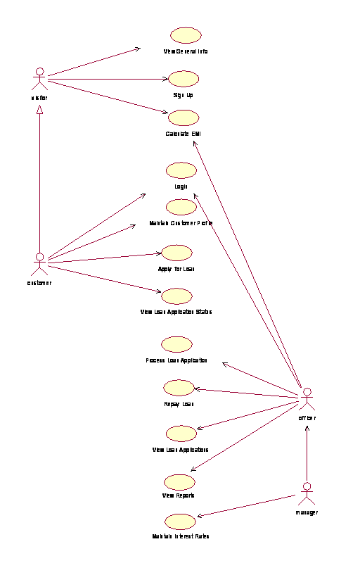
Use case diagram

Slide 19

Discussion

Slide 20
Thank you Prakash.LNS@mahindrasatyam.com

